Slide 1

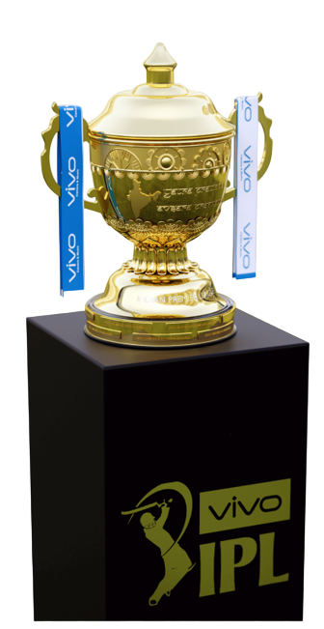

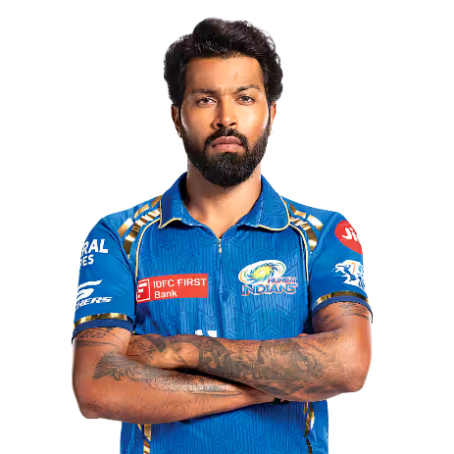


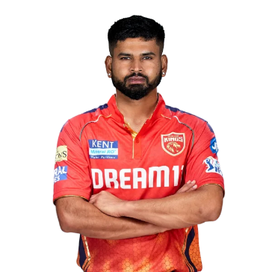
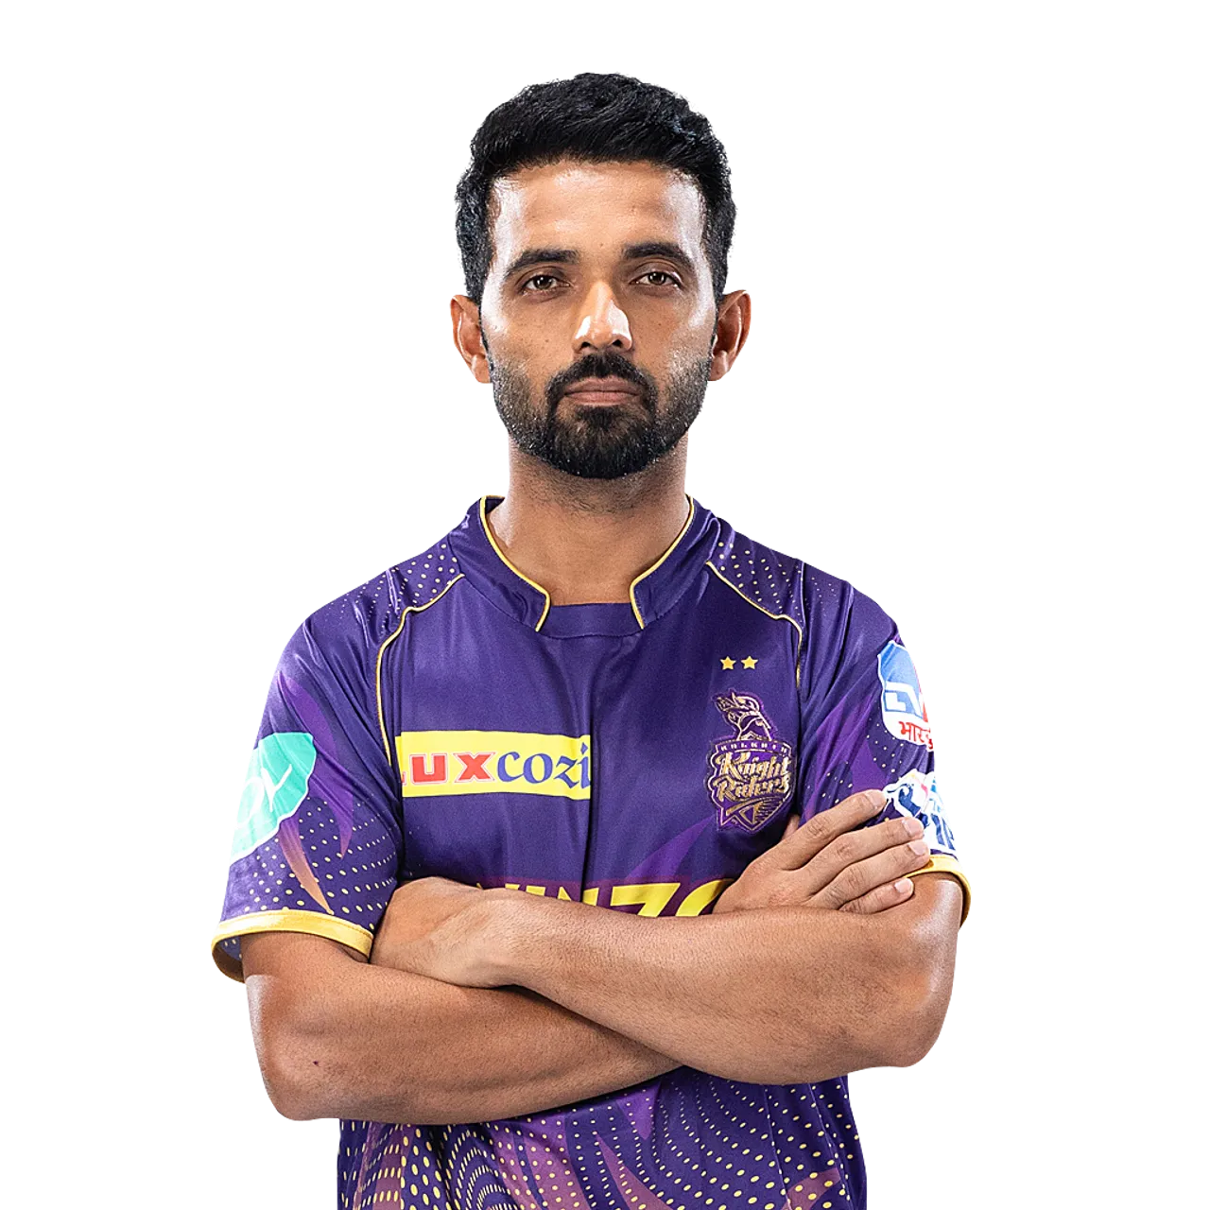
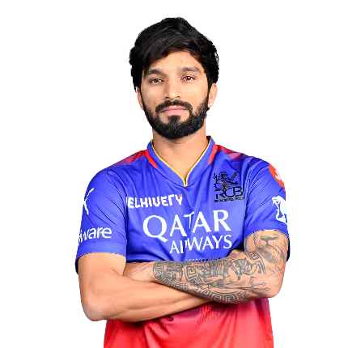
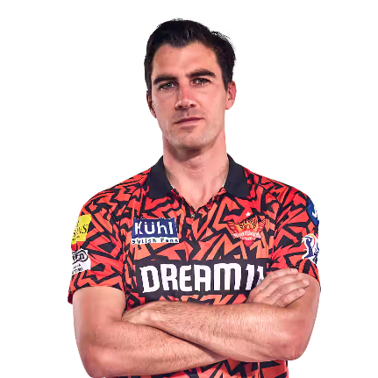

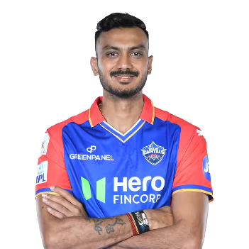
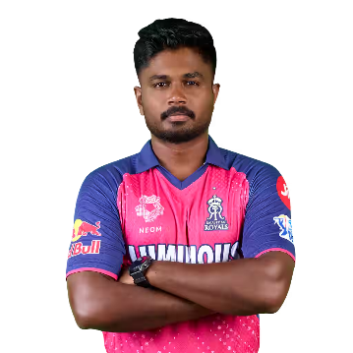

Slide 2
Project Title: Predicting IPL Match Outcomes Using Machine Learning
Student Name: Harish B
Course: DA/DS, Offline
Batch: June 2025

Slide 3


Introduction
Problem Statement:
IPL outcomes depend on complex factors (team performance, toss decisions, venue conditions).
Traditional analysis fails to capture these interactions → Need for ML-driven prediction.
Dataset Overview:
IPL match data (2008–2019) with 17+ features (teams, toss, venue, winner).
Objective:
Build a model to predict IPL match winners.
Identify key factors influencing outcomes (e.g., toss impact, venue advantage).

Slide 4










Data Understanding
Dataset Structure:
750+ matches, 17 columns (ID, Season, City, Team1/2, Toss Winner/Decision, Winner, Win Margin, etc.).
Key Variables:
Target: Winner (multiclass classification).
Features: Teams, venue, toss decision, season.

Slide 5
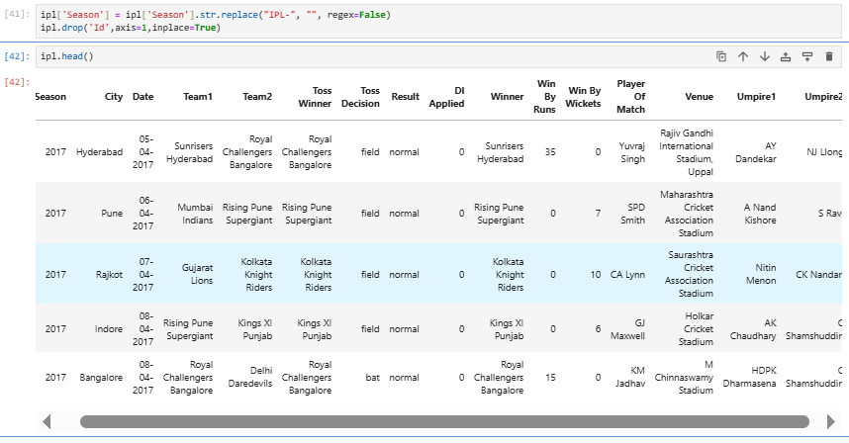
IPL Match Schedule

Slide 6





IPL Teams
Chennai Super Kings
2010 | 2011 | 2018 | 2021 | 2023
Kolkata Knight Riders
2012 | 2014 | 2024
Delhi Capitals
Gujarat Titans
2022
Lucknow Super Giants
Mumbai Indians
2013 | 2015 | 2017 | 2019 | 2020
Royal Challengers Bangaluru
Rajasthan Royals
2008
Punjab Kings
Sunrisers Hydrabed
2016

Slide 7
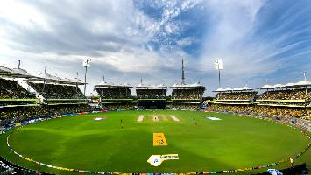
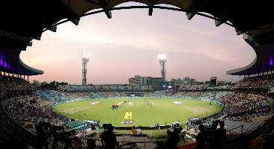
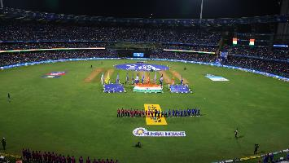
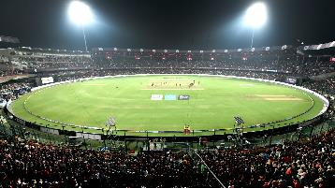
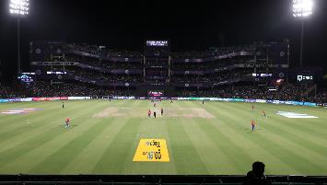
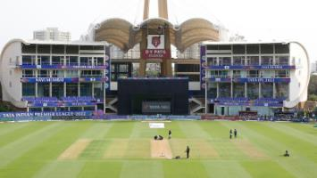
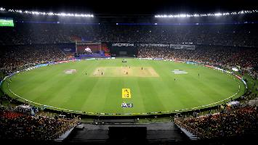
IPL Venues
M. A. Chidambaram Stadium
Eden Gardens
Wankhede Stadium
M. Chinnaswamy Stadium
Arun Jaitley Stadium
DY Patil Stadium
Narendra Modi Stadium

Slide 8
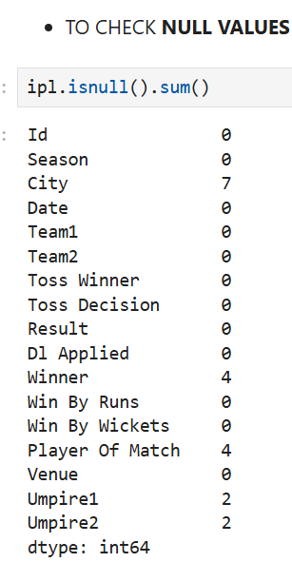
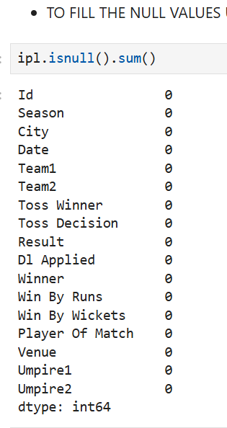
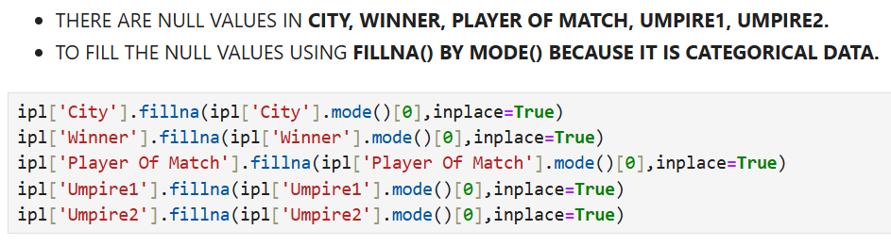
Data Cleaning
Missing Values
Imputed categorical columns (City, Winner, Umpire1/2) with mode.
Removed matches with no result.

Slide 9
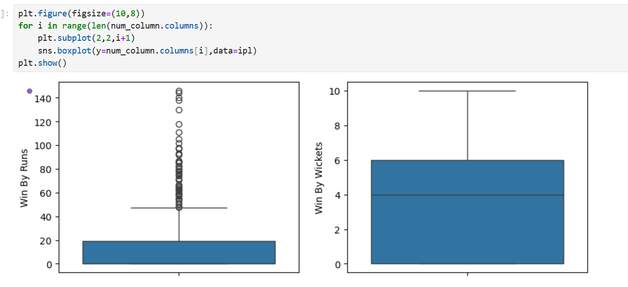
Outlier Treatment
Retained extreme win margins (e.g., 140-run wins) as real events.

Slide 10
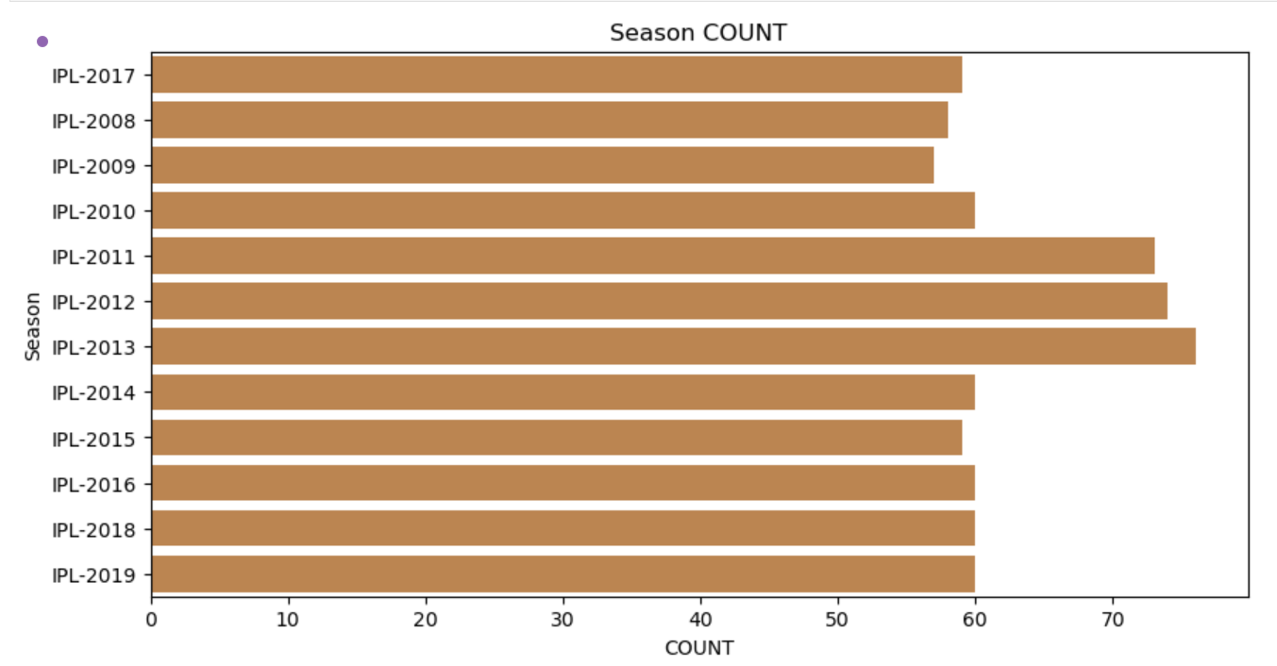
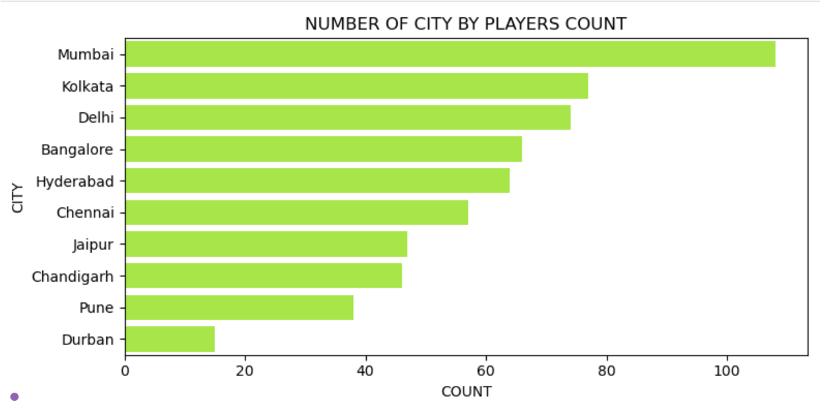
EDA - Univariate Analysis
Season Count & City Count
Dataset covers IPL seasons from 2008 to 2019.
Some seasons like 2013 had the highest number of matches.
Early seasons (2008–2010) had comparatively fewer matches.
Mumbai hosted the most matches, followed by Kolkata and Delhi.
Cities like Durban, Pune, Chandigarh had fewer matches.
Venue distribution shows IPL matches were played across many cities.

Slide 11
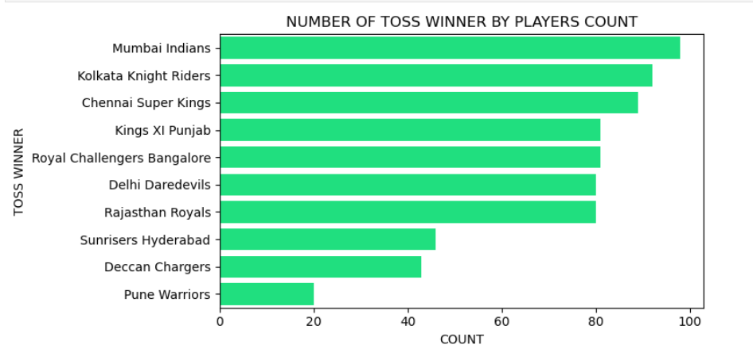
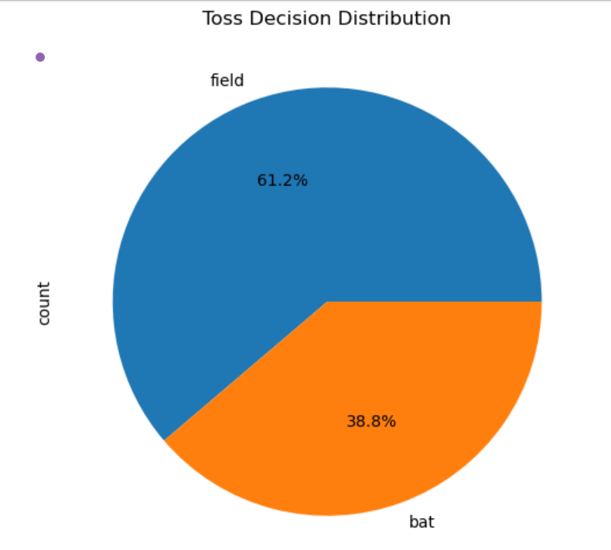
Toss Winner Count & Toss Decision Pie Chart
Mumbai Indians won the highest number of tosses.
Kolkata Knight Riders and Chennai Super Kings follow closely.
Toss wins are evenly distributed among top-performing franchises.
61% of toss winners chose to field (chasing strategy).
Only 39% of toss winners chose to bat.
Teams generally preferred chasing as a safer strategy.

Slide 12
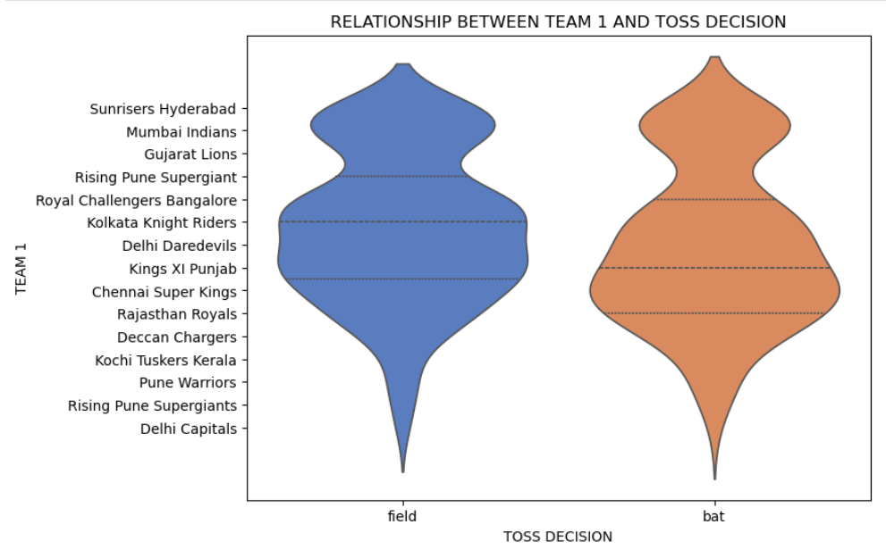
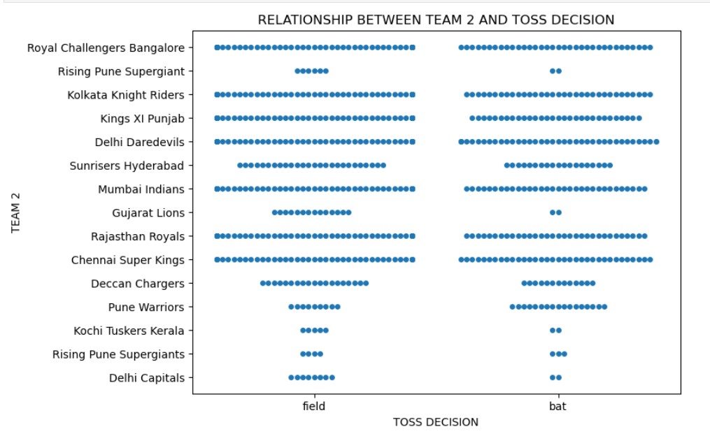
EDA - Bivariate Analysis
Team 1 vs Toss Decision & Team 2 vs Toss Decision
Teams like Mumbai Indians & KKR showed balanced toss decisions.
Some teams leaned more toward fielding first.
Toss decision patterns varied across franchises.
Similar distribution of toss decisions as Team 1.
Fielding was the most common choice.
No team had a dominant preference for batting first.

Slide 13
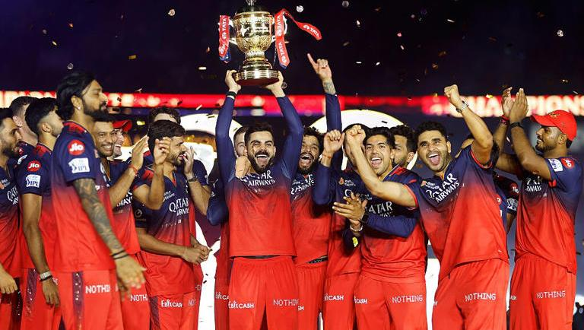
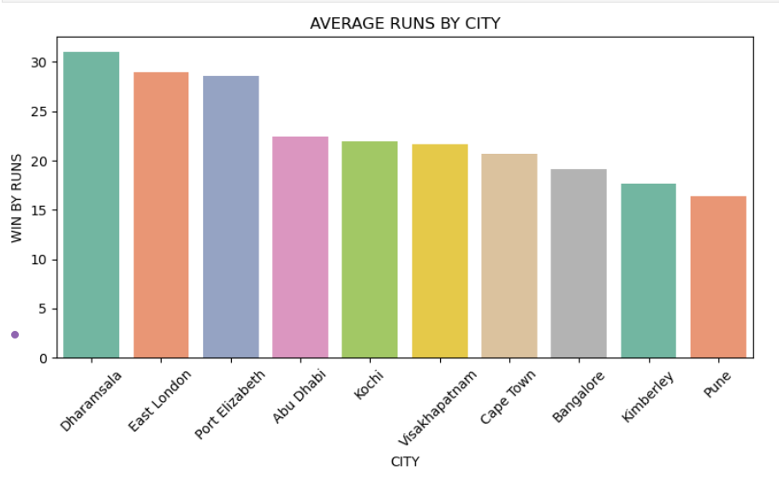
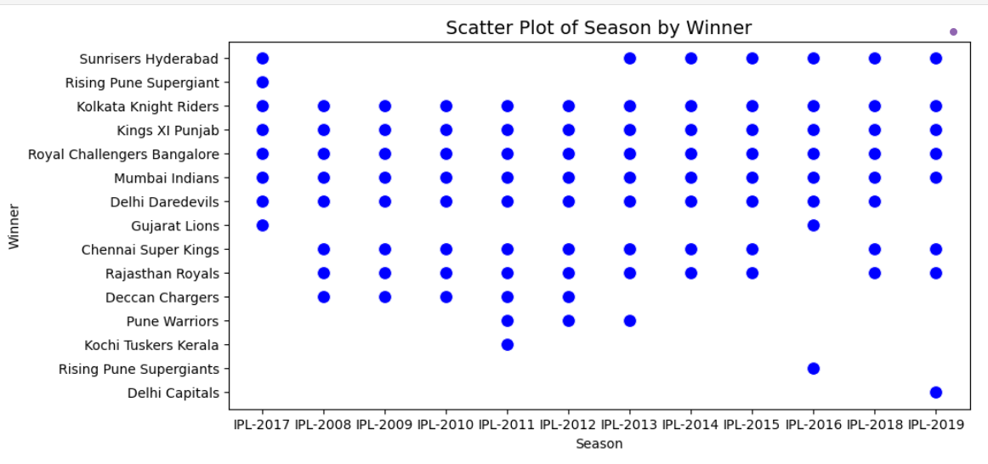
Average Runs by City & Season vs Winner Scatter Plot
Cities like Dharamsala & East London had higher average win margins.
Most cities showed runs-based wins around 20–30 runs.
Pitch and ground conditions likely influenced outcomes.
Shows which teams won in which seasons.
Teams like Mumbai Indians & CSK appear consistently across seasons.
Short-lived franchises (e.g., Gujarat Lions, Kochi Tuskers) appear in fewer seasons.

Slide 14
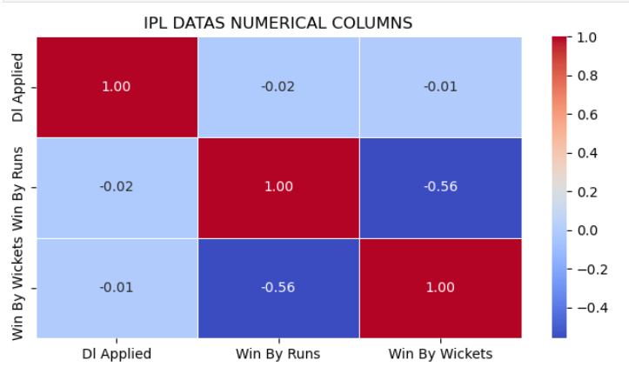
EDA - Multivariate Analysis
Correlation Heatmap
Strong negative correlation between Win by Runs & Win by Wickets.
DL (Duckworth-Lewis) method has very little correlation with outcomes.
Only one margin type (runs or wickets) dominates in each match.

Slide 15
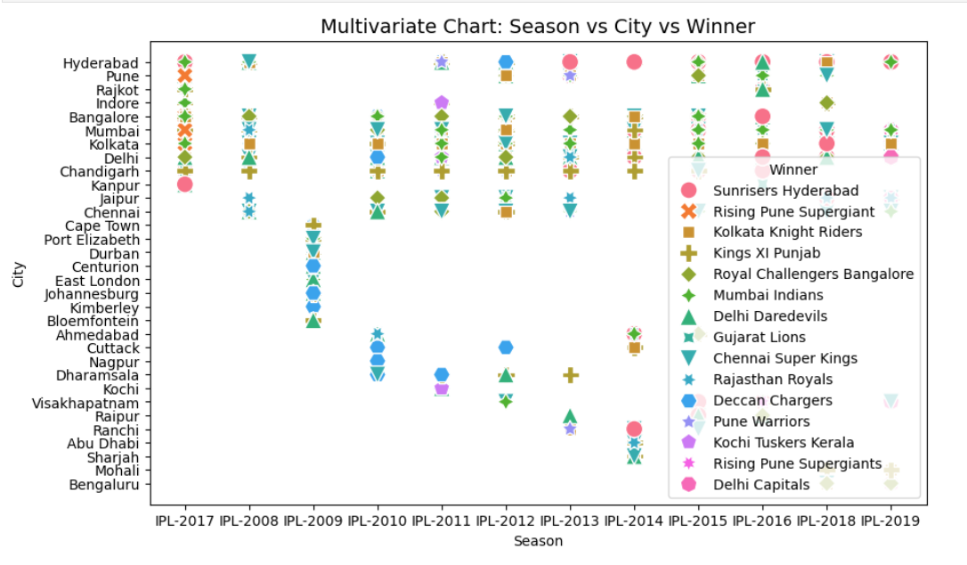
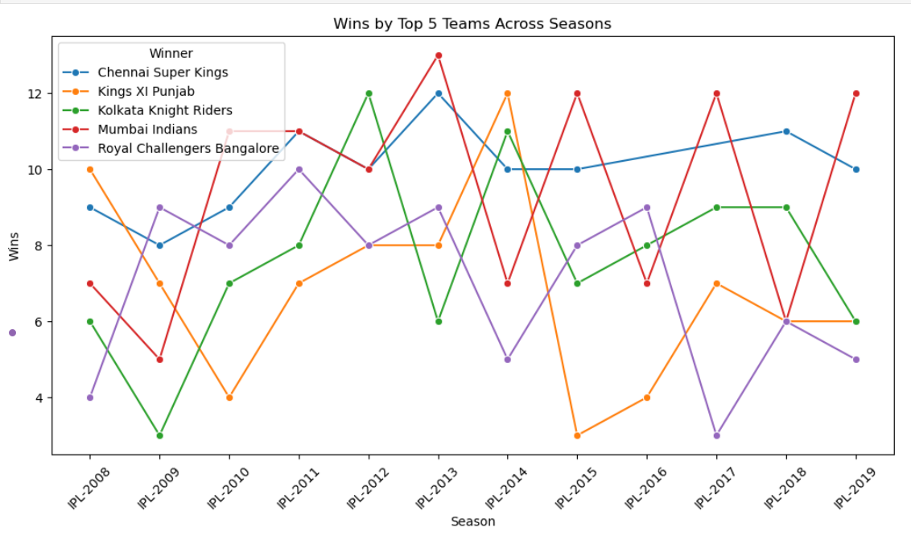
Season vs City vs Winner & Wins by Top 5 Teams Across Seasons
Different teams dominated in different venues and seasons.
Mumbai & Chennai often appear in multiple seasons.
City/venue plays a strong role in determining outcomes.
Mumbai Indians & CSK consistently strong across seasons.
Other teams like RCB & KXIP show fluctuating performance.
Seasonal team form strongly influences overall wins.

Slide 16
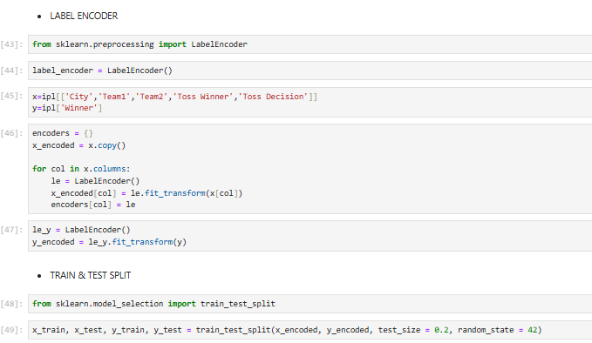
Modeling Process

Slide 17
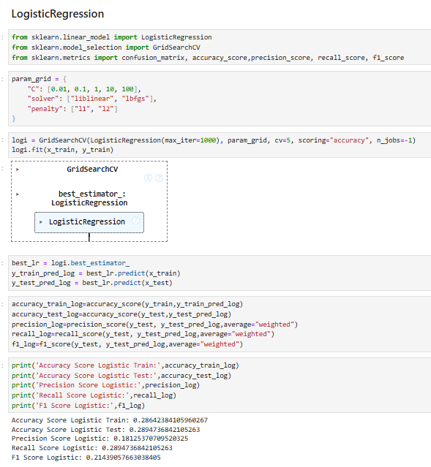
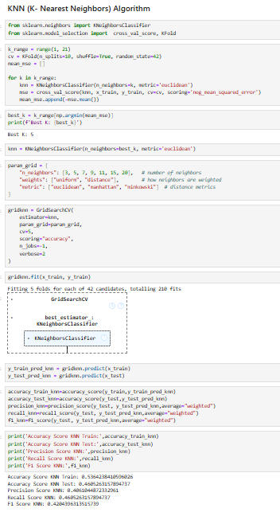
Logistic Regression & K-Nearest Neighbors
Logistic Regression
Used as a baseline model to predict match winners.
Hyperparameters like C, solver, and penalty were tuned.
Achieved low accuracy (~29%), showing limited ability to handle complex IPL data.
K-Nearest Neighbors (KNN)
Classified matches based on similarity to past matches.
Best k value was selected using cross-validation.
Performed slightly better than Logistic Regression (~30–46% accuracy), but sensitive to dataset size.

Slide 18
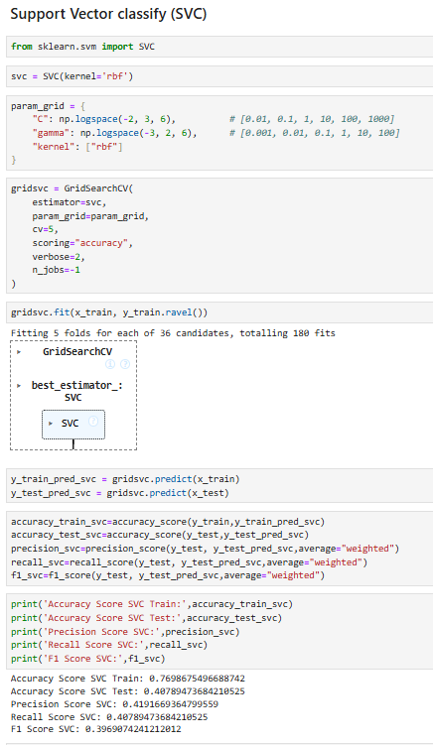
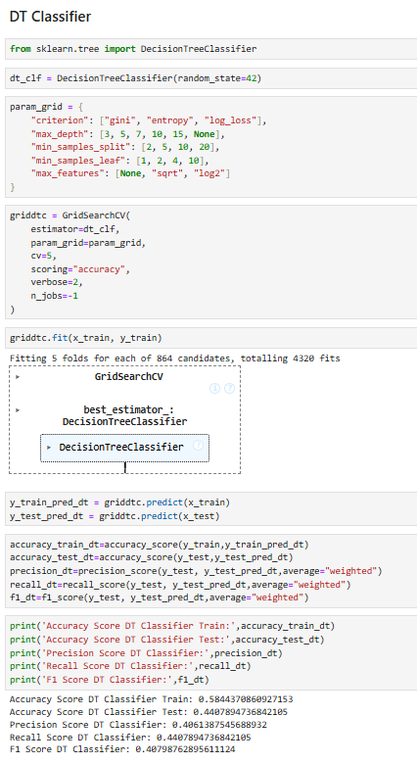
Support Vector Classifier & Decision Tree Classifier
Support Vector Classifier (SVC)
Implemented with RBF kernel to capture non-linear relationships.
Parameters C and gamma were optimized.
Accuracy (~29–41%) remained low, showing SVM struggled with categorical-heavy data.
Decision Tree Classifier
Built a tree-based model to split features for predictions.
Tuned parameters: max_depth, criterion, min_samples_split.
Achieved ~40% accuracy, better than baseline, but suffered from overfitting.

Slide 19
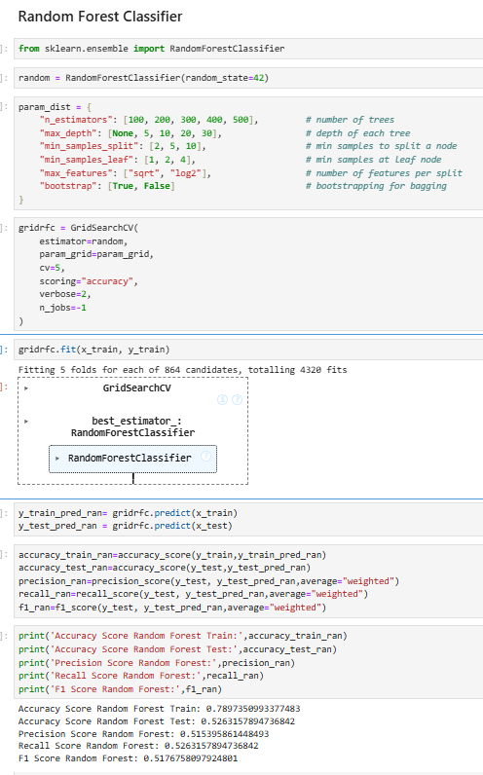
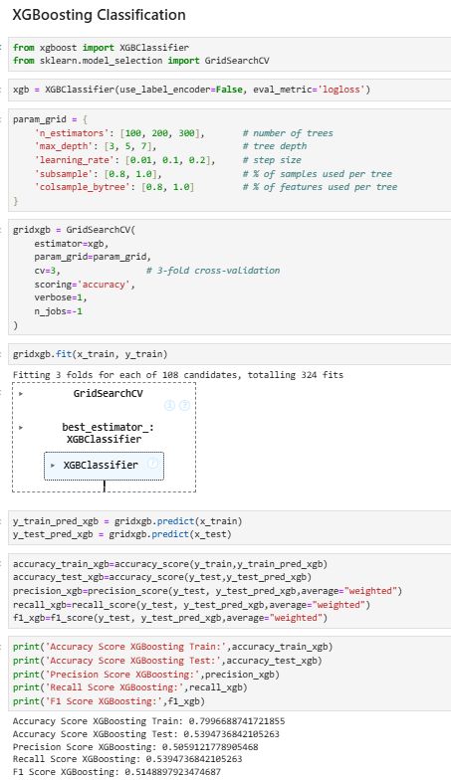
Random Forest Classifier vs XGBoost Classifier
Random Forest Classifier
Applied an ensemble of multiple decision trees to reduce overfitting.
Hyperparameters like n_estimators, max_depth, and min_samples_split were tuned.
Reached ~52% test accuracy, showing strong generalization compared to single decision trees
XGBoost Classifier
Gradient boosting model applied for high predictive accuracy.
Optimized parameters: learning_rate, n_estimators, max_depth, subsample.
Achieved the best performance (~54% accuracy), making it the final selected model.

Slide 20
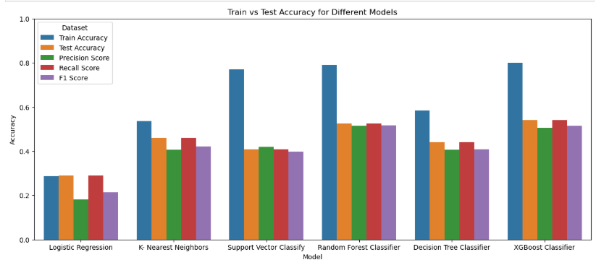
Train vs Test Accuracy with Precision, Recall, and F1 Score

Slide 21
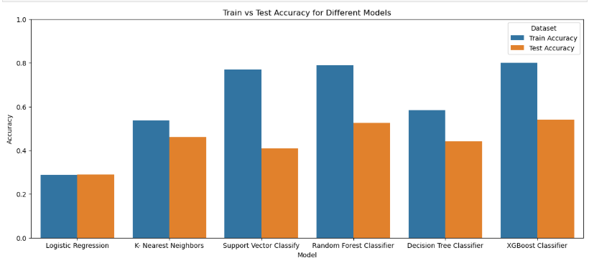
Train vs Test Accuracy Comparison

Slide 22
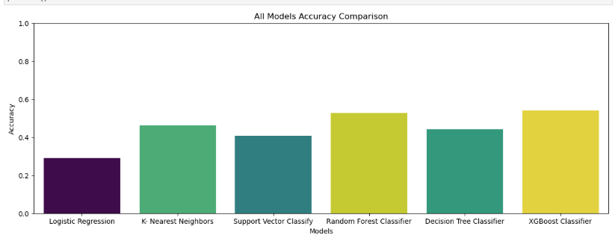
Accuracy Comparison of All Models

Slide 23
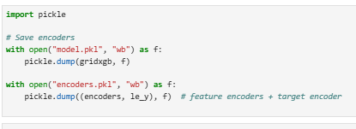
Best Model Selection and Saving
After evaluating all the machine learning models, XGBoost Classifier was identified as the best-performing model with the highest accuracy (~54%) and balanced precision, recall, and F1-score.
It consistently outperformed other models like Logistic Regression, KNN, SVC, Decision Tree, and Random Forest.

Slide 24
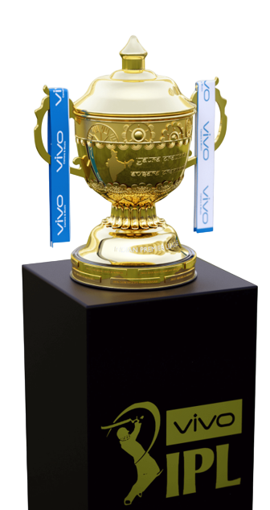
Conclusion
The IPL dataset was cleaned and analyzed to study the impact of factors like toss, venue, and team performance. Baseline models (Logistic, KNN, SVC) gave low accuracy, while Decision Tree improved results but overfitted. Ensemble models performed best, with Random Forest (52%) and XGBoost (54%) showing the highest accuracy. Finally, XGBoost was chosen as the best model and saved for future match winner prediction.

Slide 25
Thank You!

